Slide 1

Digital transformation
Dr Unben Pillay
ASAIPA | IPAF | Smart Health Africa | ATC
Notes:
My perspective is that of a practitioner:

Slide 2

Innovations
In a world grappling with complex health challenges,
innovation is not a luxury but a necessity!
Notes:
We have 1.3% of the world's health workers caring for 25% of the global disease burden.
The WHO estimates that by 2035 there will be a global deficit of about 12.9 million skilled health professionals

Slide 3

“Empowering” Practitioners
Embrace digital tools for improved efficiency.
Empower practitioners with modern technology.
Ensure continuity of care with integrated systems.
Enhance efficiency through innovation.
Enhance practice sustainability with digital tools
Notes:
Digital transformation in private practice is fundamentally about empowering the clinician.
It's about moving away from paper-based, fragmented systems to an integrated digital ecosystem.

Slide 4
Leveraging innovations to improve scope and quality of Primary Healthcare.
Artificial Intelligence
Point of Care and Diagnostics
EHR’s
TeleHealth
Mobile health

Slide 5
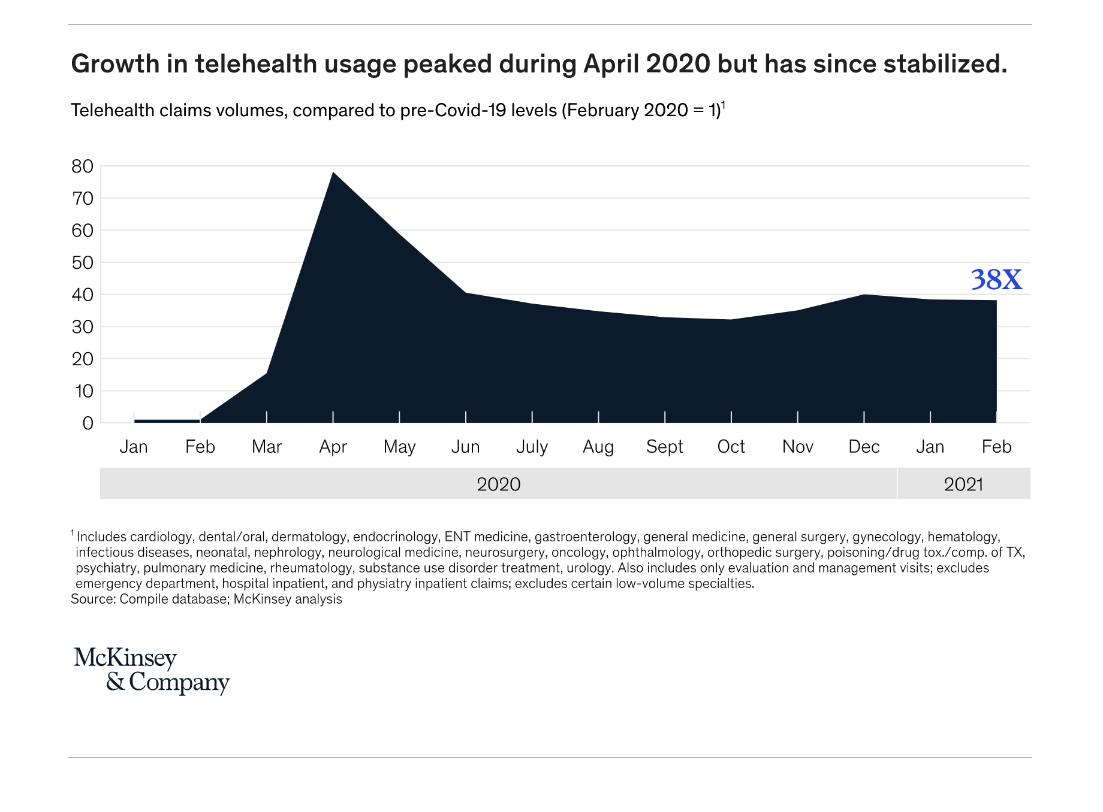
Telehealth usage peaked during June 2020 and December 2020
but declined from February 2021, telehealth utilization remains higher than pre-covid…
Notes:
We can use telehealth to dramatically improve access to care, especially in remote areas where a physical clinic visit is difficult.
This is perfect for quick consultations, prescription renewals, and managing chronic conditions like hypertension or diabetes."

Slide 6

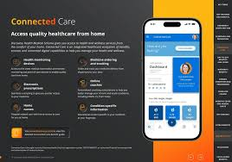
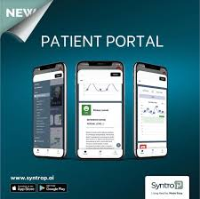
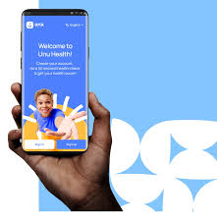

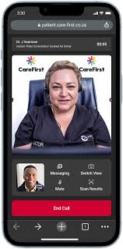





Telehealth:
Funders
Corporates
Pharmacies
Banks
Retail
Practitioners

Slide 7
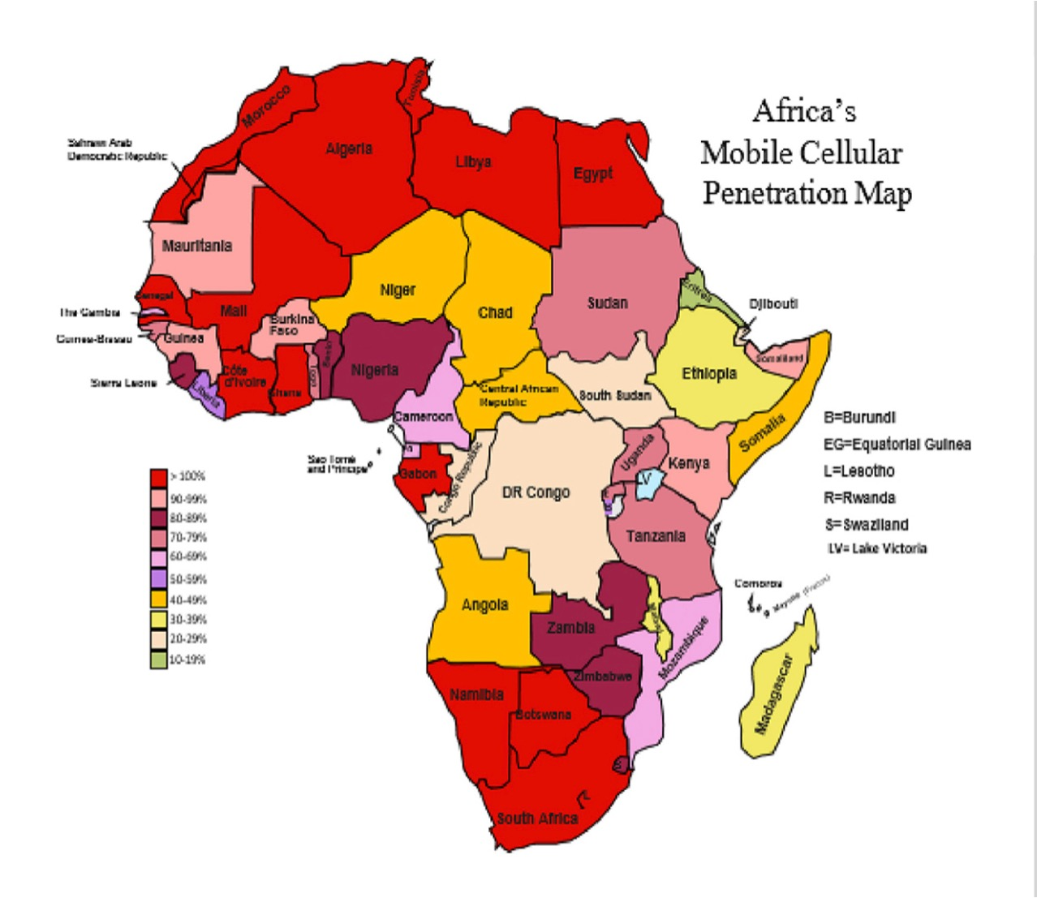
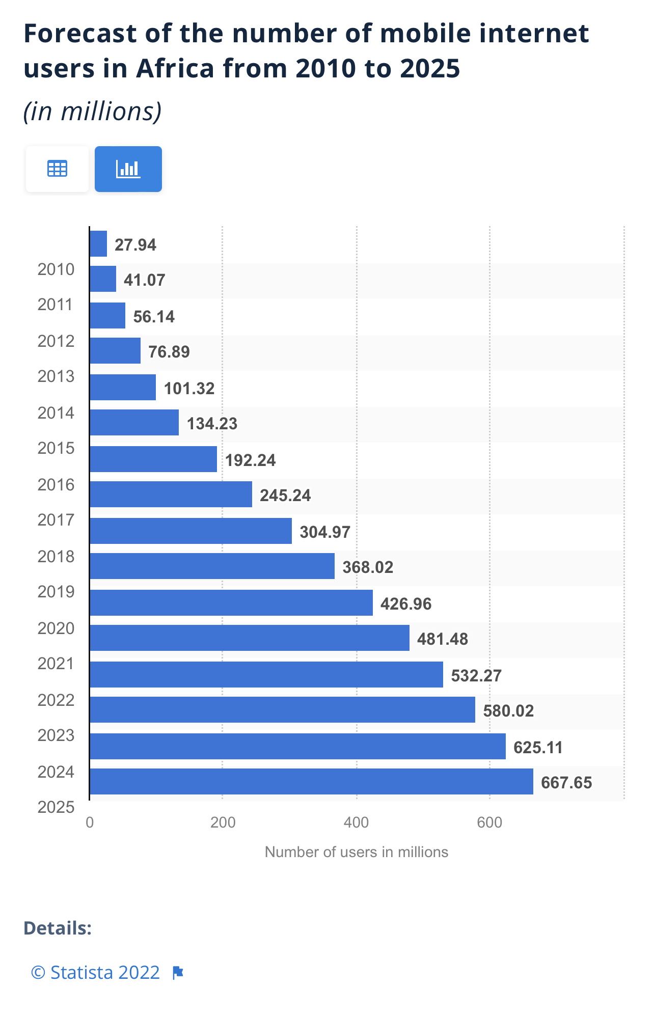
Mobile health

Slide 8

Empowering Patients:
Safe Quality Care
Ensure patient data continuity across providers
Patients securely access their health information
Adhere to strict POPIA compliance regulations
Build patient trust through data ownership
Notes:
Digital tools are also key to patient data ownership and privacy.
Patients must be at the center of this process.
We must ensure that their data is secure, that they have control over it, and that its use is transparent. This builds trust, which is the foundation of the doctor-patient relationship.
Whether a GEMS member is seeing their GP, a specialist for a chronic condition, or a physiotherapist, their health journey is visible to the entire care team, leading to better outcomes.

Slide 9

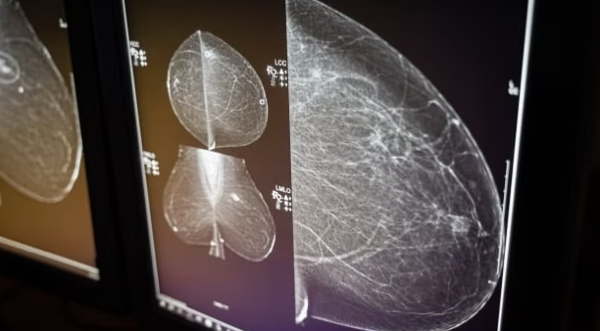

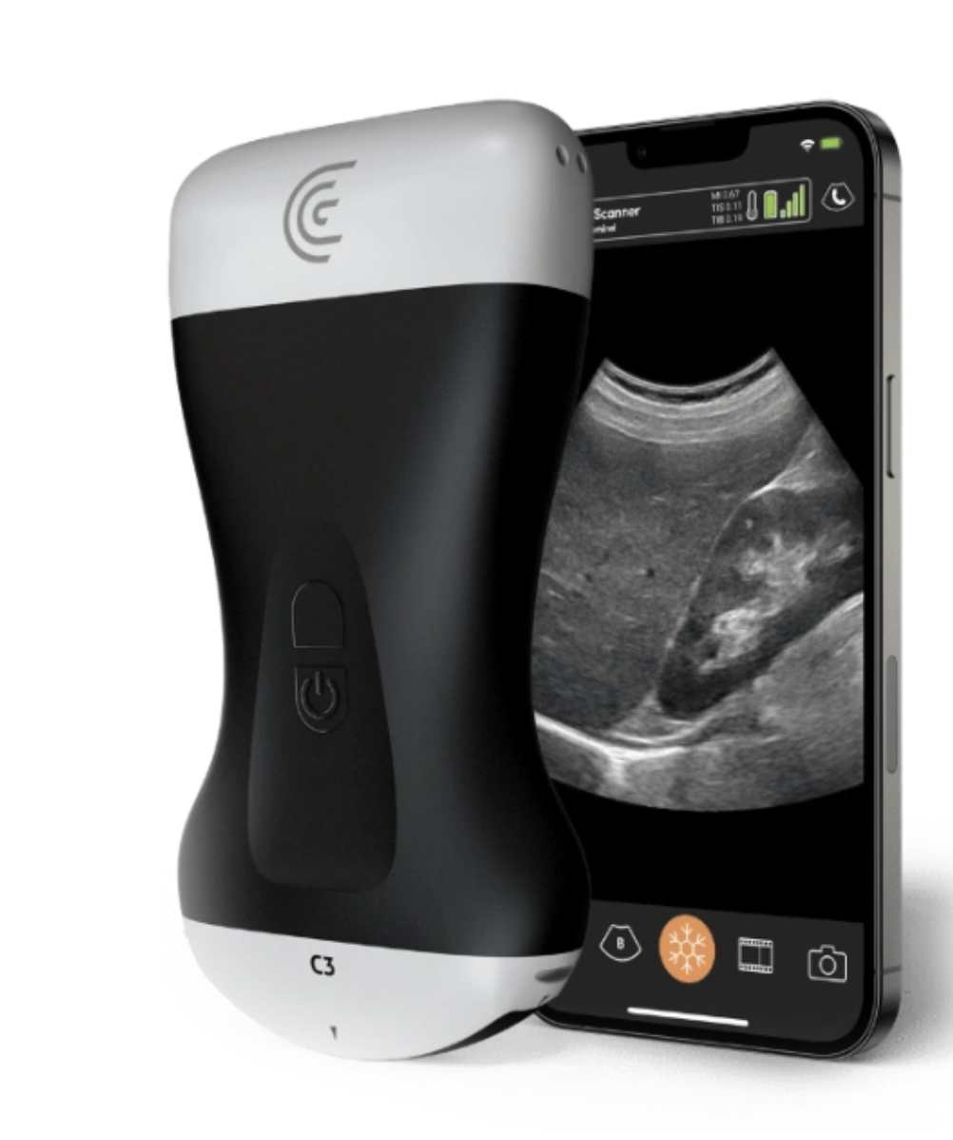

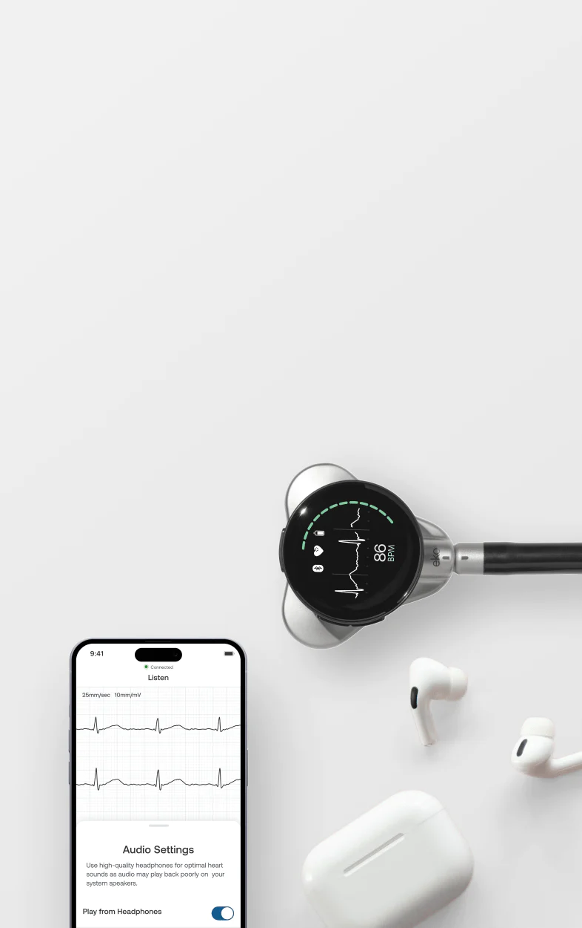
Ai : Artificial Intelligence
Eko Core 500: Digital Stethoscope and Ai platform to detect Heart murmurs and AFib
Medsol : Breast AI offers real-time breast ultrasound scanning with predictive analysis of possible malignancy, at an accuracy rate of 97,6 %
Sonography

Slide 10

Funders: Partnership for Progress
INCENTIVIZE adoption of digital tool in practices, create tariff codes, reimbursement models
PROMOTE interoperability from vendors for a connected ecosystem
PROVIDE education, resources and training for practitioners
Notes:
Funders are not just passive payers; you are the catalysts for change.
Your support is essential in driving the uptake of these technologies.
Your investment in a digitally enabled network of practitioners will not only improve clinical quality but will also lead to more efficient claims processing, better health outcomes, and a more sustainable healthcare system for all GEMS members.

Slide 11

‘The Future of Healthcare is Digital.’

Slide 12
Thank You
Dr Unben Pillay

