Slide 2

Dr Mpho Rabada
GEMS Trustee
The Impact of Wellness Programmes on Reducing Long-Term Costs

Slide 3

Topics
Background
Prioritising prevention and screening
Progress and challenges
Unlocking value
The way forward

Slide 4
BACKGROUND

Slide 5


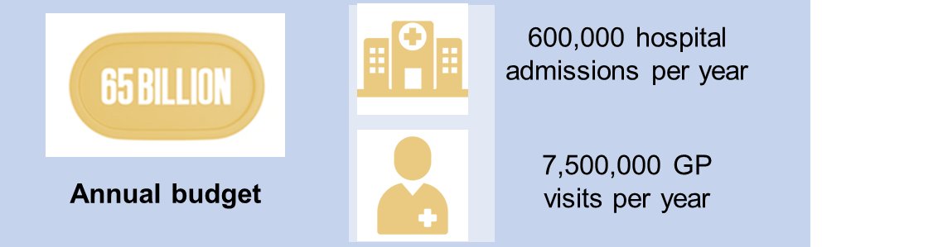
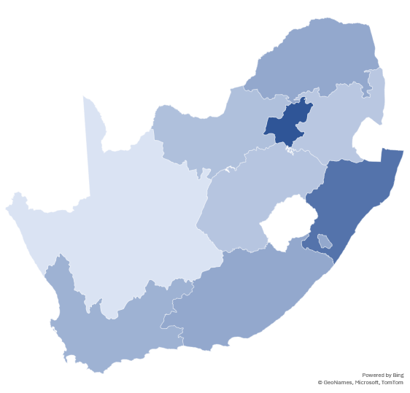
Background
GEMS is the largest restricted & second largest overall medical scheme in South Africa, with voluntary membership for public servants
Covering over 25% of all beneficiaries nationally, it plays a key role in advancing access, affordability, & equity in healthcare, while leveraging its scale for cost efficiency & improved health outcomes
2.4 million
Covered beneficiaries as at
June 2025
886 thousand
Covered members as at
June 2025
Notes:
The REPI model for GP on the network. Assisst to make health and wellness and prevenative

Slide 6

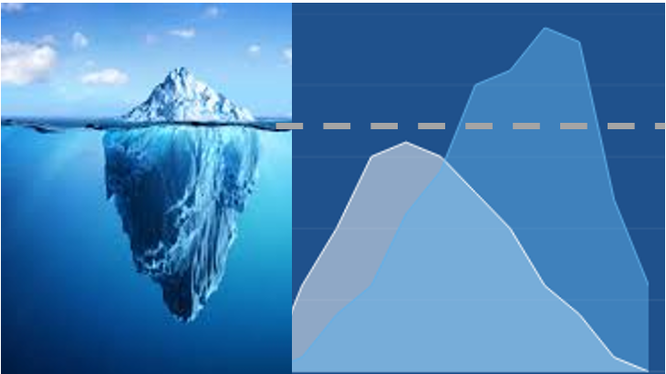
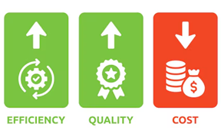
Background
There are two types of healthcare funders, namely passive healthcare funders and active healthcare funders. GEMS is an active funder.
A passive funder simply collects contributions and pays out claims.
Iceberg
An active funder ensures that the value which members derive is maximised. Healthcare outcomes are improved and costs are contained.

Slide 7


Background
SA Top 6 Diagnosis in registered deaths due to diseases
Diabetes overtook COVID-19 as the leading cause of death, reflecting a shift back to chronic disease burden
Diabetes Mellitus
Tuberculosis
Ischaemic Heart Disease
HIV/AIDS
Hypertensive Disease
Cerebrovascular Disease
2024-2025
SA Top 10 Diagnosis in registered hospital admissions
Mental health admissions are increasing
Diabetes Mellitus
Tuberculosis
Mental health disorders
Ischaemic Heart Disease
HIV/AIDS related conditions
Non-communicable diseases like diabetes and hypertension are overtaking infectious diseases
Hypertensive Disease
Cerebrovascular Disease
Cancers
Pregnancy and childbirth
Injuries from accidents

Slide 8
Background
Active funding is especially important in the context of a severe and deteriorating disease profile. The prioritisation of preventative care is a central tenet of active funding.

Slide 9
Background
Province
Departments

Slide 10
Prioritising Prevention and Screening

Slide 11

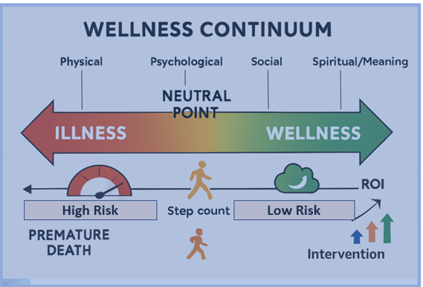
Prioritising Prevention and Screening
World Health Organisation
Health is a state of complete physical, mental and social well-being and not merely the absence of disease or infirmity
A medical scheme that only pays for treatment is like a fire department that waits until the house is engulfed in flames before acting. By that stage, the damage is catastrophic, the costs are enormous and recovery may never fully restore what was lost.

Slide 12

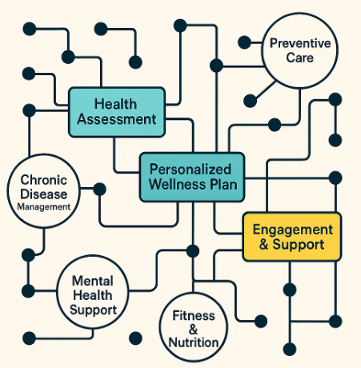
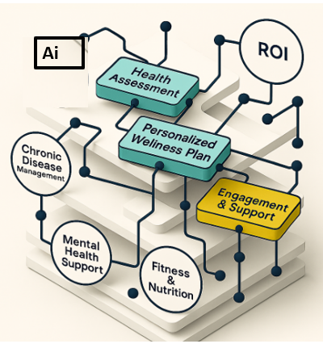


Prioritising Prevention and Screening
A medical scheme which prioritises wellness and prevention is like a community which invests in fire safety from the ground up.
It ensures every home is built with smoke detectors, fire-resistant materials and clear escape plans.
It runs education campaigns, so families know how to prevent sparks from ever catching.
ID- Health risk
Quantify the risk
Manage the risk
Proactive
Integrated
Fit for life Fit for work Fit for purpose
Connecting the dots

Slide 13

Prioritising Prevention and Screening
The result is fewer fires, less devastation and stronger and safer communities.
Prevention does not just save money—it saves lives and preserves value. Just as smart firefighting is about preventing fires before they start, smart medical aid is about keeping people well long before illness takes hold.
Country economic competitiveness index
  Skills preservation and expertise preservation
  Talent pipelines protection
  Recruitment cost
  Innovation
  Family cohesion
  Community capacity building

Slide 14



Prioritising Prevention and Screening
Blood pressure monitoring
Cholesterol careening
Glucose screening
Peak flow measurement
GEMS offers market leading preventative and screening benefits across all its options.
Hearing screening
Neonatal hypothyroidism
Optometric screening

Slide 15



Prioritising Prevention and Screening
Osteoporosis screening
LIFE EXPECTANCY
Chlamydia testing
HIV testing
Syphilis testing
TB testing
Early ART initiation leads to nearly close to normal life expectancy
GEMS offers market leading preventative and screening benefits across all its options.
TOP 5 CAUSES OF CANCERS IN SA
Facal occult blood test
Mammogram
Pap smear
Prostate screening
1- Breast
2- Prostate
3- Cervical
4- Lung
5- Colorectal

Slide 16



Prioritising Prevention and Screening
HPV vaccine
Influenza vaccine
Pneumococcal vaccine
Polishing
Sealants
GEMS offers market leading preventative and screening benefits across all its options.
Glaucoma screening
Pregnancy screening
Pre and post exposure prophylaxis

Slide 17
Progress and Challenges

Slide 18


Progress and Challenges
In addition to the provision of extensive benefit entitlements,
GEMS promotes the adoption of screening and preventative care services by incentivising healthcare professionals to champion screening and preventative care and by educating members on the importance of screening and preventative care.
Steady incremental improvements are evident but nonetheless there is tremendous room for improvement.
Mammograms
Examples
Flu vaccines

Slide 19
Progress and Challenges
68.4% increase in flu vaccine coverage (2015 to 2024). Progress was stunted by the Covid-19 pandemic and coverage is yet to fully recover subsequent to the pandemic.
21.0% increase in mammogram coverage (2015 to 2024). Progress was stunted by the Covid-19 pandemic and coverage is yet to fully recover subsequent to the pandemic.

Slide 20
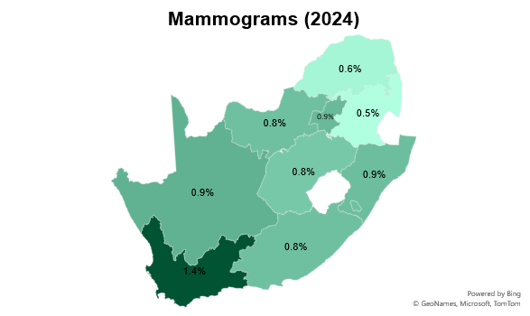
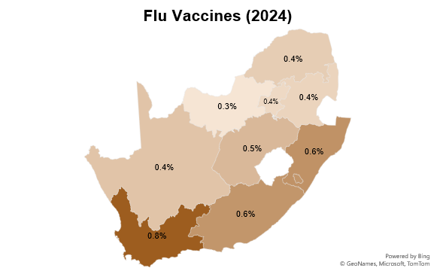
Progress and Challenges
Coverage varies by region. North West underperforms with a 3.3% coverage, whilst the Western Cape excels at 7.8%. This further highlight opportunities for improvement.
Coverage varies by region. Mpumalanga underperforms with 5.3% coverage, whilst the Western Cape excels at 13.9%. This further highlight opportunities for improvement.

Slide 21
Progress and Challenges
Higher income earners are associated with higher coverage rates than lower income earners despite beneficiaries receiving the same benefits. This too highlights opportunities for improvement.

Slide 22
Unlocking Value

Slide 23






Unlocking Value
Empowering Members
Empowering Healthcare Professionals
Innovating into the future
GEMS maintains a multipronged and continually evolving strategy to unlock additional value through the promotion of wellness and screening initiatives. Value takes the form of improved healthcare outcomes and lower downstream costs.

Slide 24


Unlocking Value
Empowering Members
Educating members on their benefit entitlements (payable from risk)
Educating members on the importance of screening and preventative care
Educating members on how best to navigate the healthcare system
Wellness events in collaboration with the employer
Hyper-personalised communications aimed at high-risk beneficiaries identified using a combination of AI and advanced analytical techniques

Slide 25
Unlocking Value
Empowering Healthcare Professionals
Providing direct funding for the efforts involved in supporting screening and preventative care. For example, tariff codes which allow GPs and nurses to be reimbursed for performing pap smears.
Implementing results-based reimbursement models through which professionals receive enhanced consultation tariffs for being associated with more favourable process measures. This includes screening and preventative care.
Implementing innovative value-based care programs whereby multidisciplinary teams of healthcare professionals assume responsibility for holistically coordinating care. Professionals receive value-based capitation fees. This includes the GEMS Population Medicine Initiative.

Slide 26


Unlocking Value
Empowering Healthcare Professionals: GEMS Population Medicine Initiative
Multidisciplinary care teams known as clinical consortia have been constructed to deliver primary care services.
Care team include general practitioners, physicians, nurse care coordinators, psychologists and social worker.
Members of the care team collaborate to ensure that patients receive coordinated care in line with best practice guidelines.
The capitation fees payable to the care teams are linked to downstream cost savings. This helps to incentivise cost-effective care.
The capitation fees payable to the care teams are linked to processes and surrogate outcome measures. This helps to incentivise high-quality care including screening and preventative care.

Slide 27

Patient Specific Entitlements
POPULATION MEDICINE
Reductions in the number of preventable admissions: asthma (0.5%), HIV (8.2%), dehydration (18.7%) and UTIs (12.8%)
A 1.0% reduction in overall admission rate for beneficiaries with chronic conditions

Slide 28

Unlocking Value
Innovating into the future
Technological innovations are being leveraged to drive improved wellness by enabling personalised healthcare, promoting healthier lifestyles and expanding access to preventative and supportive solutions.
GEMS funds continuous glucose monitors (CGM) for type 1 diabetics up to age 18.
CGM empower patients to manage their blood sugar levels proactively and to reduce the risk of chronic complications.
Further such initiatives are being continuously investigated.

Slide 29
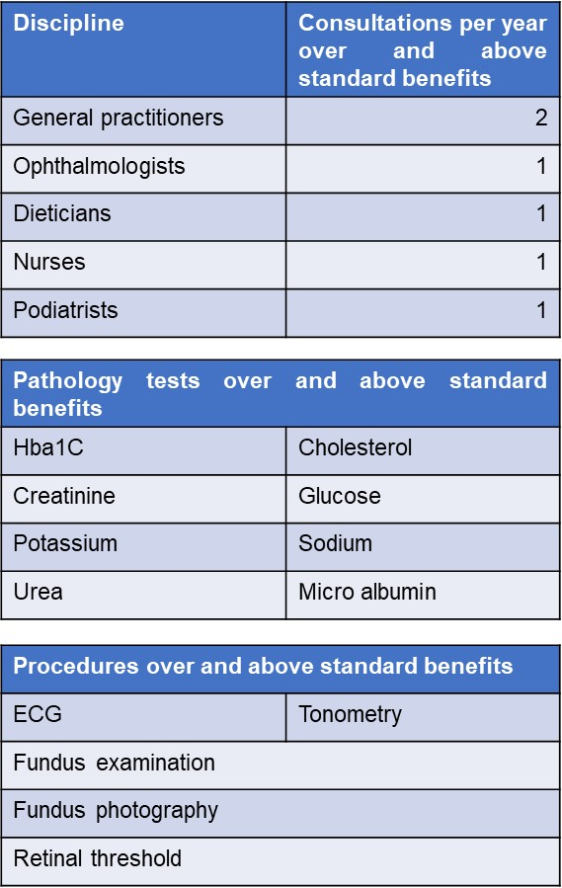
Unlocking Value
Innovating into the future
Wellness programs foster healthier habits and behaviours and create supportive environments which enhance individual well-being.
GEMS is trialing a weight management program aimed at overweight beneficiaries.
The program provides patients with extraordinary benefits for medicines needed to support weight loss, consultations with general practitioners and dieticians as well as the pathology tests needed for the oversight of weight management.
Further such programs are being continuously investigated.

Slide 30
The Way Forward

Slide 31




The Way Forward
INVESTMENT
BEHAVIOUR
NOTIFICATION
RETURNS
ESG Strategic Alignment
I
B
N
R
Employer Shared Value
Community Shared Value
Brand Shared Value
Investing resources
Behavior modulation
Process & Data mining
Risk mitigation
INPUT
OUTPUT
METHOD
TARGET
.

Slide 32

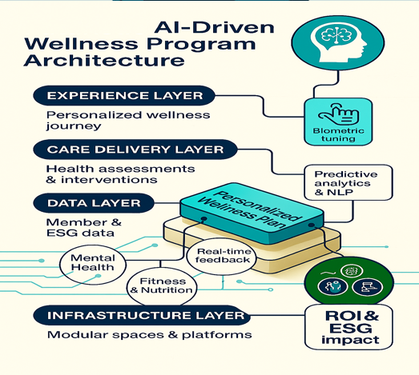
The Way Forward
Unlocking Value
The promotion of wellness, screening and preventative care requires close collaboration between funders, providers and members.
New technologies and innovative strategies must be leveraged.

Slide 33

THANK YOU
We look forward to hosting you next year!

