Slide 1

GEMS SYMPOSIUM
“Building a Sustainable and Affordable Future: Enhancing
Member Value in a Changing Healthcare Landscape”
PRESENTATION BY THE PSCBC GENERAL SECRETARY:
MR FRIKKIE DE BRUIN

Slide 2


INTRODUCTION
THE FOLLOWING PRESENTATION IS DERIVED FROM A COMPREHENSIVE MEMBER FEEDBACK FROM TWO SURVEYS THAT WERE CONDUCTED WITH GEMS MEMBERS
The presentation covers the following:
What’s Working 👍
Key Challenges Identified ⚠️
Member-Driven Solutions 💡
Recommendations 🎯

Slide 3
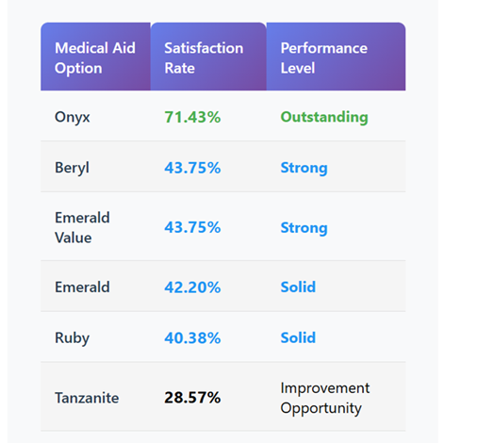
WHAT IS WORKING
BENEFIT OPTION SATISFACTION LEVEL
(COMPLETE SATISFACTION RATINGS)

Slide 4
WHAT IS WORKING
BENEFIT OPTION SATISFACTION LEVEL
(TOP PERFORMER & STRONG PERFORMERS)
🥇👑
TOP PERFORMER
Onyx
71.43%
Satisfaction
Rate
🥈👑
STRONG PERFORMERS
Beryl &
Emerald Value
43.75%
Satisfaction
Rate

Slide 5
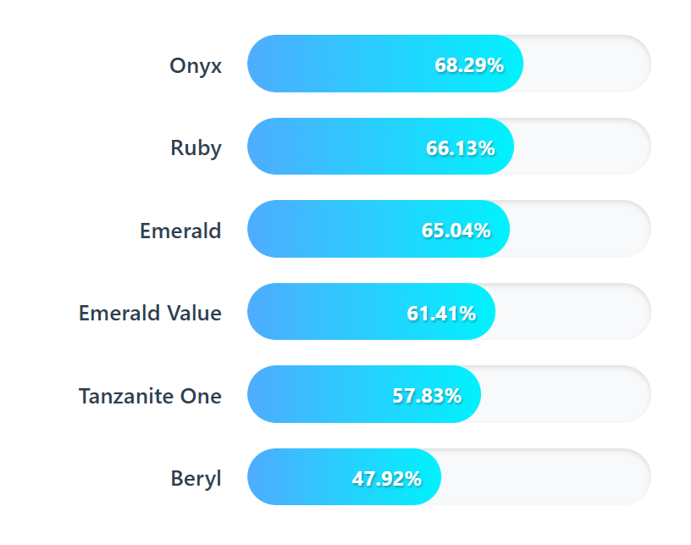
WHAT IS WORKING
RATING THE COMPREHENSIVE COVERAGE (COMBINED POSITIVE RATINGS
(ADEQUATELY, WELL & VERY WELL)

Slide 6
CHALLENGES
FINANCIAL CHALLENGES – AFFORDABILITY CRISIS💰📉
Premium & Contribution Burden 💵
Option plans cost too much compared to public servant salaries
Members struggle with monthly contributions
Forced trade-offs between upgrading for better coverage or downgrade to manage costs
Out-of-Pocket Strain 🏦💊
Mid-Year Crisis: Annual benefits exhausted early, forcing personal payments
Medication Gaps: Lack of cover for some essential or chronic prescriptions
Cash Flow Issues: Members face financial hardship when benefits run out
Delayed Care: High out-of-pocket costs deter members from seeking necessary treatment

Slide 7

CHALLENGES
ACCESS AND NETWORK LIMITATIONS 🚑📍
Geographic Barriers
Rural Access Crisis 🏞 – fewer healthcare providers accepting GEMS in rural areas
Urban Concentration 🏙 – limited network expansion beyond major cities
Health Care Provider Limitations: Restricted choice due to network constraints
Administrative & Structural Obstacles 🗂⏳
GP’s Referral Requirements 🩺 – mandatory referrals before specialists drain funds
GEMS Payment Delays 💳 – slow reimbursements to service providers makes scheme to be an unattractive payment method.
One-Size-Fits-All Plans 🧩 – benefits that don’t match member needs (e.g., maternity benefits for post-childbearing members)

Slide 8
CHALLENGES
TRANSPARENCY & SERVICE DELIVERY GAPS 🔍☎️
Information & Communication Gaps
No Monthly Statements 📄 – members can’t track benefits
Poor Coverage Transparency ❓ – unclear benefits & provider rates
Billing Surprises 💥 – unexpected costs from lack of fee schedule
Hidden Costs 🕵️ – out-of-network charges & coverage limits catch members off guard
Customer Service Deficiencies 😞📞
Inefficient Support Systems 🖥 – poor call centre & walk-in centres customer support
Long Waiting Times ⏱ – inadequate assistance and delayed response time
Poor Query Resolution ❌ – inadequate handling of member complaints and concerns

Slide 9
MEMBER- DRIVEN SOLUTIONS
SERVICE EXCELLENCE TRANSFORMATION 🚀🤝
Customer Service Overhaul 🛠 – More staff, better training, and strict quality assurance
Technology Integration 💻⚡ – Digital tools and automation to speed up responses
Professional Standards 🎯 – Match or exceed industry benchmarks for healthcare service
Digital Self-Service 📱🖱 – Member-friendly online tools for account and benefits management

Slide 10
MEMBER- DRIVEN SOLUTIONS
PERSONALISED HEALTHCARE SOLUTIONS 🏥
Segmented Plan Design 🧩 – Tailored benefits for:
  👩‍💼 Young professionals starting careers
  👨‍👩‍👧 Families with children
  👴 Pre & post-retirement members
  💵 Lower-income workers
Life Stage Optimisation 📈 – Coverage that evolves with changing needs

Slide 11
MEMBER- DRIVEN SOLUTIONS
TRANSPARENCY & COMMUNICATION REVOLUTION 🔍💬
Monthly Statements 📄 – Regular updates on fund balances & benefit usage
Clear Coverage Information 📚 – Simple, detailed explanations of benefits and coverage
Provider Fee Transparency 💳 – Mandatory upfront disclosure of fee schedules to avoid surprises

Slide 12
MEMBER- DRIVEN SOLUTIONS
VALUE-ADDED HEALTH BENEFITS 🌿💪
Preventative Wellness Programs 🏃‍♂️🥗 – Incentives for healthy lifestyle choices
Chronic Care Management 💊 – Specialised support for ongoing health conditions
Lifestyle Behaviour Programs 🧘‍♀️🌸 – Holistic health and wellness initiatives

Slide 13
RECOMMENDATIONS
🔄 CONTINUAL REVIEW OF GEMS OFFER TO MATCH EVOLVING MEMBER’S NEEDS.
🔄 Continual review of GEMS offer to match evolving member’s needs.
📊 Data-Driven Decision Making:
🧩 Member Segmentation Research: Understanding diverse member needs through regular research and analytics.
😊 Satisfaction Analysis: Systematic identification of pain points and improvement opportunities.
🗣️ Voice-of-Customer Programs: Regular feedback collection and implementation.
🔮 Propensity Modelling: Predicting and addressing member needs proactively.
💰 Sustainable Cost Management:
🤝 Ongoing Network Negotiations: Competitive pricing agreements with providers.
📉 Long-term Affordability: Controlling premium increases while maintaining quality coverage.

Slide 14

Thank You!!

